Slide 1
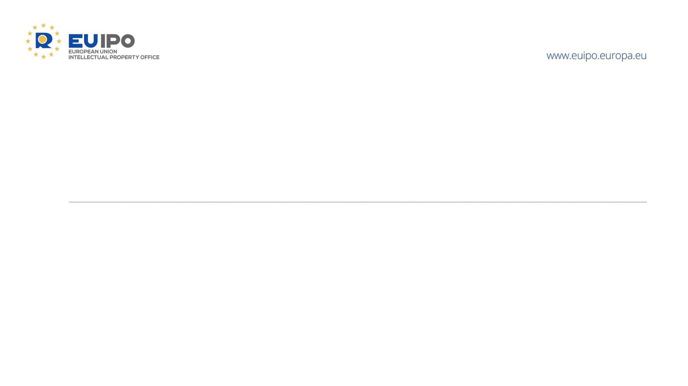
Designs on the Edge: Lessons from Recent Board of Appeal Case Law
Gordon Humphreys
Chairperson, 1st and 3rd Boards of Appeal
IP Case Law Conference
EUIPO Alicante, 21 April 2026

Slide 2

Why ‘on the edge’?
Design law lives on the edge of three tensions:
Appearance vs. Function
Digital Evidence vs. Legal Proof
Fair Competition vs. Abusive Tactics
Notes:
INTRO: Why we’re talking about “designs on the edge”
Good morning, everyone! It’s great to be here with such an experienced group of professionals. Now, I called my talk “Designs on the Edge” and you’re probably asking yourselves what I mean by that? Well, design law is increasingly living at the intersection of three key tensions:
1. Appearance vs. Function – How much design freedom do creators actually have when designs are constrained by technical requirements?
2. Digital Evidence vs. Legal Proof – With so much disclosure happening online, what counts as reliable, provable evidence?
3. Fair Competition vs. Abusive Tactics – When do competitive actions cross the line into unfair play, and how does the law protect designers from this?
These tensions often play out before the Third Boards of Appeal, which is dedicated to design cases.

Slide 3
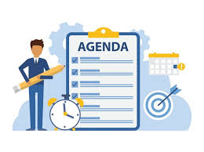
Agenda
Internet Disclosure and Evidentiary Standards
Abusive Disclosure and Article 7(3) Protection
Functionality and Procedural Pitfalls
Notes:
Recent case law has shown something important:
Design protection is still strong—but only for those who can prove it properly, argue it precisely, and frame it correctly.
We’ll walk through three main themes today:
1. Internet Disclosure and Evidentiary Standards
2. Abusive Disclosure and Article 7(3) Protection
3. Functionality and Procedural Pitfalls

Slide 4
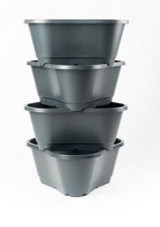
Internet Disclosure — When Proof is Everything
Lidl vs. Gusta Garden (R2089/2024-3)
Key Facts:
Design: Modular plant containers (plant towers) filed in 2019.
Lidl challenged the design as non-novel.
Evidence: Facebook posts, screenshots, search results.
Notes:
1. Internet Disclosure: When Proof Is Everything
Let’s dive right in with a deceptively simple question: When is something truly “disclosed online”?
Take, for example, the 2025 case involving a stackable plant container (R2089/2024-3). The design in question? The modular plant tower you can see on the slide.
The case involved Gusta Garden GmbH’s EU design for these plant containers, filed in 2019.
Lidl challenged it, claiming – among other grounds – that the design wasn’t new, and providing evidence of disclosure of prior art that included:
• Facebook posts
• Screenshots
• Search engine results
• Even internal company presentations.
Now, when we look at the legal analysis of disclosure, we run into a very important point: Digital evidence is only as good as its ability to be verified.
Here’s the bottom line:
The Board took a strict approach. For online disclosures to be valid, there must be objective, verifiable, and traceable evidence. No assumptions, no vague digital traces, no undated screenshots (or, as in this case, contradictory dates on the same document).

Slide 5
Internet Disclosure — When Proof is Everything
Lidl vs. Gusta Garden (R2089/2024-3)
Lidl’s Arguments:
Invalid representation of the design.
Lack of novelty — prior disclosure.
Technical functionality — purely cost-optimized.
Notes:
To prove disclosure, Lidl tried to use:
• D1: A blurry internal presentation from 2019.
• D2: A search result from Bing in 2017—well, that was problematic, as the results were unreliable and even contradictory. It was indicated as being ‘on or before 14 March 2017’, which was imprecise, and then
• D3: A YouTube video and Amazon listing from 2018.

Slide 6
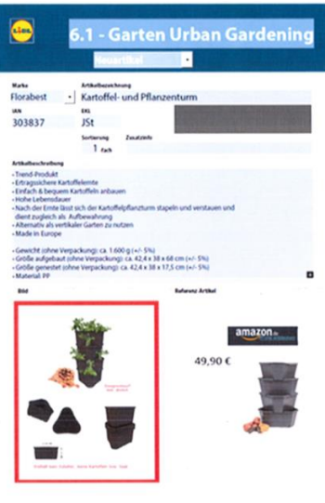
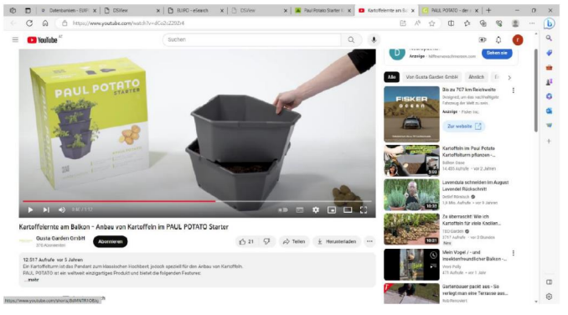
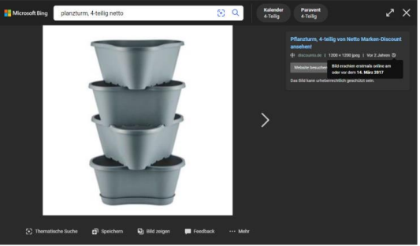
Internet Disclosure — When Proof is Everything
Lidl vs. Gusta Garden (R2089/2024-3)
Lesson 1: Traceability of Online Evidence
Visual: Screenshot of an Amazon listing with a clear timestamp -> OK
BUT -> NOT OK:
A blurry internal presentation from 2019.
Undated screenshots.
A 2017 Bing search result from Bing in 2017 - unreliable and contradictory (CP 10).
Takeaway: To invalidate a design using online disclosure, ensure complete, reliable, and traceable evidence.
Notes:
What happened? The Board found that the internet evidence was inconclusive because it was insufficiently reliable. It wasn’t about “digital = bad,” but about whether digital evidence could be properly traced and shows clear images of alleged prior art. A subsequent clearer photo of the images in the digital evidence was unable to help, since it was completely unclear who took this photo and when and under what circumstances it was taken. The Bing search engine merely provided links to various websites and displayed previews of the images contained on those websites. It wasn’t a reliable sources —because it didn’t archive data like proper archives or registries do. Moreover, it contained a reference to the Notre Dame fire which was after the alleged date of disclosure. Those doubts could not be dispelled by expert evidence, since uncertainty still remained about primary and secondary metadata access using Bing. This strict approach is in line with CP 10 Criteria for assessing disclosure of designs on the Internet – agreed by the Member State IP offices.
So, what can we learn here? To invalidate a design using online disclosure, you need clarity, certainty and traceability—blurry, undated or dubiously dated screenshots simply won’t cut it. In the event, an Amazon listing with a clear timestamp was sufficient – although the contested design ended-up being found not to lack novelty when compared to that disclosed image, since the two designs differed in more than insignificant details.

Slide 7
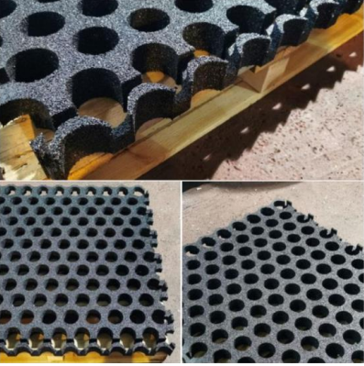
Abusive Disclosure — When the Past is "Too Dirty" to Count
Building Slabs Case (R 1483/2024-3)
Scenario: Designs were disclosed but allegedly stolen.
Issue: Misappropriated disclosures within the grace period are ignored - Article 7(3)
Notes:
2. Abusive Disclosure: When the Past is “Too Dirty” to Count
Next let’s consider what happens when prior designs exist, but they are alleged to have been disclosed unfairly? This brings us to the "building slabs" case (R 1483/2024-3).
In this case, the designer of a building slab argued that previous disclosures, shown on Facebook, were stolen from him. This was a classic case of Article 7(3) of the Design Regulation, which protects designers from abusive disclosure—particularly when prior designs were exposed during the grace period under conditions of misappropriation.
The legal question here was: Does the publication count as “prior art” if the disclosure happened under unfair or abusive circumstances?

Slide 8
Abusive Disclosure — When the Past is "Too Dirty" to Count
Building Slabs Case (R 1483/2024-3)
Prior disclosure is discounted if it was made in bad faith.
Misappropriation or copying raises doubts about fairness.
Example: Designs that were shared between (former) business partners with ample opportunity for potential misappropriation.
Notes:
What did the designer argue?
• He provided drawings and prototypes dating back to 2012-2013 to show he was the original designer.
• He proved that former partners had access to his work and were in a position to misuse it.
• And crucially, the timing of the other design’s emergence that was produced suspiciously quickly and with an uncanny closeness to the original drawings and prototypes—indicated potential copying.

Slide 9
Abusive Disclosure — When the Past is "Too Dirty" to Count
Building Slabs Case (R 1483/2024-3)
How disclosures came into existence matters, not just when.
Ensure NDAs and post-employment clauses are in place to avoid abusive disclosures.
Notes:
The key takeaway here is: Even if something has been disclosed publicly, abusive disclosures can be legally ignored under Article 7(3). This case underscores the importance of former partners signing non-disclosure agreements and post-employment restrictions to prevent this type of misappropriation.
So, prior art is not just about what exists; it’s about how it came into existence. If the prior disclosure is abusive, then it doesn’t count—and the design holder can still protect their rights.

Slide 10
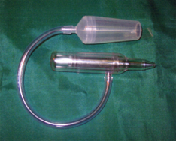
Functionality — "It’s more than just a tube!"
Breathing Device/Nasal Aspirator (R-1800/2025-3)
Argument: The design is purely functional — no aesthetic choices allowed.
Test: Design protection requires freedom in aesthetics, not just function.
Notes:
Lastly, let’s turn to
3. Functionality: And when “Just being a tube” is not enough.
In fact, the allegation that the contested design is purely functional, is one of the most common defences in design law.
In the case about a nasal aspirator for babies (R-1800/2025-3), - that you can see on the scene - the invalidity applicant argued that the design was purely functional. He said it was nothing more than a “tube” with a chamber and a nose tip. According to the invalidity applicant, because every part of the design was “functional,” it didn’t deserve protection.
But here’s the crucial point: A design cannot be protected if all its features are dictated solely by function—not “most,” all.

Slide 11
Functionality — "It’s more than just a tube!"
Breathing Device/Nasal Aspirator (R-1800/2025-3)
DOCERAM v. CeramTec (2018) — A design cannot be protected if all features are solely dictated by function.
Conclusion:
  Prove that the design is just a "functional" object and includes no features with any aesthetic freedom.
  It’s not about whether the product works, but if the designer had meaningful freedom of choice (e.g. multiple solutions for a suction head and other components).
Notes:
And guess what? The Board found that a functionality allegation will fail if the invalidity applicant can't prove that all aspects of the design are dictated by necessity. It wasn’t enough to argue that the tube, chamber, or nose tip were functional. There were ergonomic features, safety considerations, and comfort factors that showed the designer still had some room for aesthetic freedom.
The key takeaway here: Functionality is not about whether the product works. It’s about whether the designer had enough meaningful freedom to incorporate aesthetic or non-functional features. In this case, the Board concluded that design protection was justified because the design wasn’t purely dictated by function.

Slide 12

Final Thoughts
Online evidence must be clear, traceable and probative.
Context of prior art matters — abuse or misappropriation can invalidate disclosure.
Functionality claims need to prove lack of design freedom
Notes:
So, what can we learn from all three of these cases?
1. Internet evidence must be clear, complete and probative: No undated screenshots, no search engine results with contradictory information. Aim for verifiable and traceable records.
2. Context matters when it comes to prior art: If a disclosure is abusive, it may be legally ignored. Misappropriation is as important as the existence of the design itself.
3. Functionality is a high bar: You must prove a complete lack of design freedom to invalidate a design on functional grounds. If any non-functional feature exists, the design remains protected.
Closing Message
While product appearance continues to be central to design law, in an increasingly digital age you may need to think about how you prove what existed online, how you explain the historical context, and how you substantiate technical necessity or aesthetic considerations of design products.
The edge of design law today isn’t in the design itself—it’s in the evidence. So, whether you’re trying to protect a design protection or invalidate one, always remember: The devil is in the details—and in the proof.
Thank you!

